Slide 1

Abstraction:

Slide 2
What is Abstraction :
Abstraction is the process of hiding the implementation details and showing only the functionality to the user.

Slide 3


Real life example :

Slide 4
How to achieve abstraction ?
There are two way to achieve abstraction in java:-
Abstract class (0 to 100%) work.
Interface(achieve 100% abstraction) work.

Slide 5
Abstract class :
Non abstract class :
class man{
}
abstract class:
Abstract class man{
}

Slide 6
Abstract example :
public abstract class Mobile { abstract void sendMessage(); }
public abstract class Ramim extends Mobile { abstract void sendMessage();{ System.out.println("Hi , iam ramim "); } }

Slide 7
Abstract method :
If you want a class to contain a particular method but you want the actual implementation of that method to be determined by child classes, you can declare the method in the parent class as an abstract.
abstract keyword is used to declare the method as abstract.
You have to place the abstract keyword before the method name in the method declaration.
An abstract method contains a method signature, but no method body.
Instead of curly braces, an abstract method will have a semoi colon (;) at the end.

Slide 8
Abstract method :
Example :
public abstract class Employee {
private String name;
private String address;
private int number;
public abstract double computerPay();
}

Slide 9
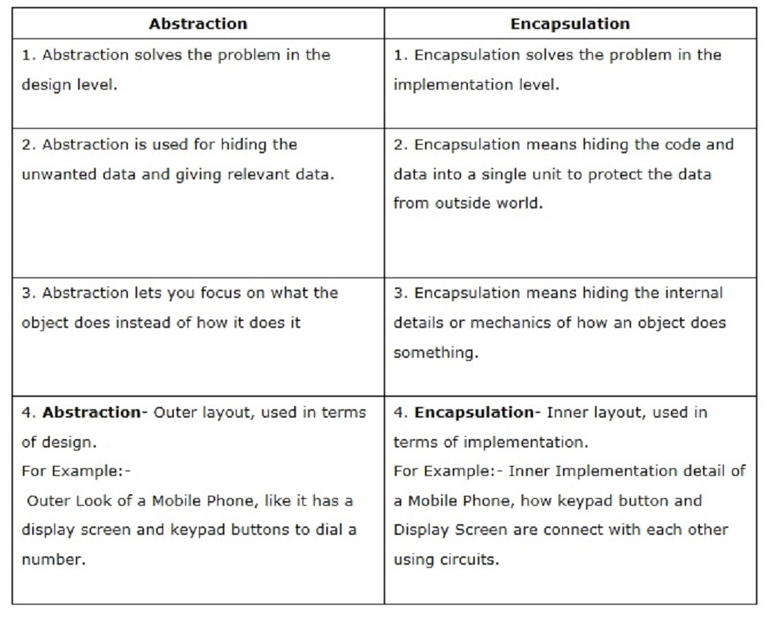
Difference between Abstraction vs Encapsulation :

Slide 10
Thank You
For watching
My lecture

